Slide 3
BACKGROUND & AIMS:
Biomarkers are used frequently for noninvasive monitoring and treatment decision making in the management of patients with ulcerative colitis (UC). This American Gastroenterological Association (AGA) guideline is intended to support practitioners in decisions about the use of biomarkers for the management of UC.
serum C-reactive protein (CRP)
fecal calprotectin,
fecal lactoferrin

Slide 4
Inflammatory bowel diseases
comprising Crohn’s disease (CD) and ulcerative colitis (UC) are estimated to affect more than 7 million individuals worldwide.
UC is characterized by periods of relapsing–remitting activity, resulting in considerable morbidity.
Up to 1 in 5 patients with UC may undergo definitive surgery in the form of a total colectomy, often for medically refractory disease.
The direct and indirect costs attributable to UC are considerable and continue to increase.

Slide 5
The therapeutic target has shifted from symptom resolution alone to a combination of symptomatic and endoscopic remission (Mayo Endoscopic Score [MES] 0 or equivalent) or improvement (MES 0 or 1)
Achievement of endoscopic remission or improvement is associated with superior outcomes:
lower risk of relapse ,need for corticosteroids, hospitalizations, colectomy, and colorectal neoplasia.
There is an important need for understanding how noninvasive biomarkers may serve as accurate and reliable surrogates for endoscopic assessment of inflammation and whether they can be more readily implemented in a UC care pathway.

Slide 6
Biomarkers are defined biological molecules that are quantifiable in tissue or body fluid (blood, stool, and urine) that represent an underlying biological disease process.
Various biomarkers have been investigated extensively in UC for several outcomes, including prediction of onset; establishing diagnosis; assessing disease activity; prognosticating natural history, including likelihood of colectomy prognosticating natural history, including likelihood of colectomy; and assessing postcolectomy outcomes.

Slide 7
cut offs :
C-reactive protein: 5 ± 5 mg/L or 0.5 ± 0.5 mg/dL
fecal calprotectin: 250 ±50 mg/g, 150 ± 50 mg/g 50 ± 50 mg/g
fecal lactoferrin: normal or elevated

Slide 8
PICO (Patients, Intervention, Comparator, and Outcome) questions focusing on biomarker cutoffs to either detect or rule out moderate to severe endoscopic activity, the preferred outcome was direct consequences on patient important outcomes
For our analysis, we used the following 3 illustrative scenarios:

Slide 9
Low pretest probability of having moderate to severe inflammation:
These include patients with asymptomatic UC (no rectal bleeding and normal to mild increase in stool frequency, RBS 0, and SFS 0 or 1), on stable maintenance therapy, or having recently achieved symptomatic remission after treatment adjustment.
The expected prevalence of moderate to severe endoscopic inflammation in these patients is approximately 15%.

Slide 10
2. Intermediate pretest probability of having moderate to severe inflammation:
These include patients with mild symptoms of UC, such as infrequent rectal bleeding (RBS 0 or 1) and/or increased stool frequency (SFS 2 or 3).
The prevalence of moderate to severe endoscopic inflammation in these patients is approximately 50%.

Slide 11
3. High pretest probability of having moderate to severe inflammation:
These include patients with typical symptoms of active UC with frequent rectal bleeding and significant increase in stool frequency (RBS 2 or 3 and SFS 2 or 3). The prevalence of moderate to severe endoscopic inflammation in these patients is approximately 85%.

Slide 12
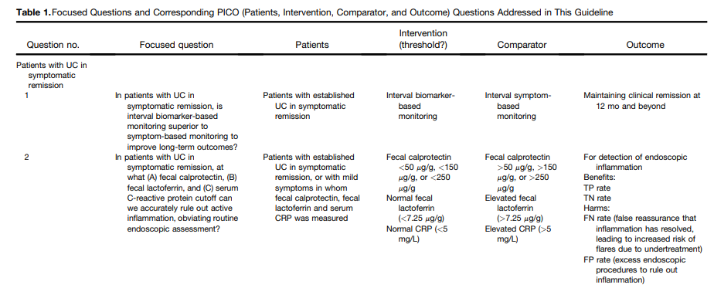

Slide 14
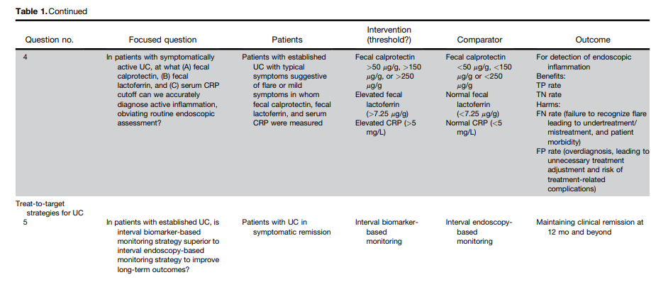
true-positive [TP], true-negative [TN], falsepositive [FP], and false-negative [FN]

Slide 15
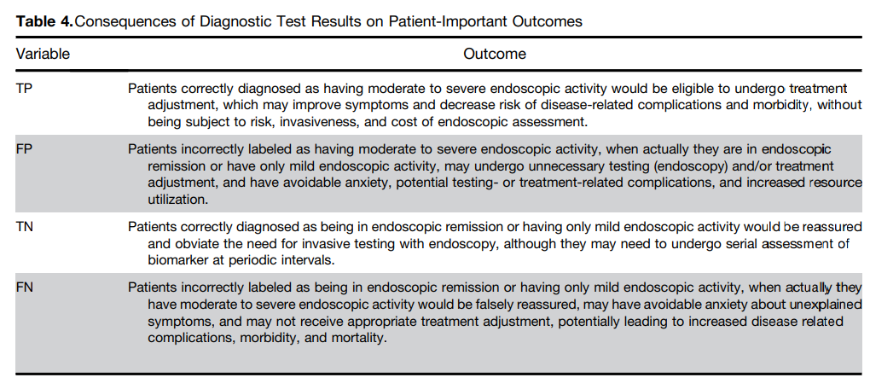

Slide 16
The serum and fecal biomarkers in this guideline are not specific for UC activity.
Serologic biomarkers, such as CRP, may be influenced by concurrent systemic illnesses, as well as other co-existing inflammatory diseases
Fecal markers, although more specific for intestinal inflammation, are not specific for UC disease activity and may be elevated in other inflammatory diseases of the gut, including infectious gastroenteritis and drug-induced colitis

Slide 17
Recommendation

Slide 18
Patients with ulcerative colitis in symptomatic remission

Slide 19
In patients with UC in symptomatic remission, the AGA suggests a monitoring strategy that combines biomarkers and symptoms, rather than symptoms alone.
Comment: Patients who place high value on avoiding burden of biomarker testing, over a potentially higher risk of flare or overtreatment, may reasonably choose interval symptom-based monitoring.
Interval biomarker monitoring may be performed every 6–12 mo.
Fecal biomarkers (fecal calprotectin or fecal lactoferrin) may be optimal for monitoring and may be particularly useful in patients where biomarkers have historically correlated with endoscopic disease activity.
A biomarker-based monitoring strategy, especially using stool-based tests, however, may be inconvenient and elevated biomarkers in otherwise asymptomatic individuals may lead to high patient anxiety

Slide 20
In patients with UC in symptomatic remission, the AGA suggests using fecal calprotectin <150 mg/g, normal fecal lactoferrin, or normal CRP to rule out active inflammation and avoid routine endoscopic assessment of disease activity Implementation considerations:
In patients who have recently achieved symptomatic remission after treatment adjustment in the preceding 1–3 mo, fecal calprotectin < 50 mg/g may be preferred over < 150 mg/g to detect endoscopic improvement (MES 0 or 1)
Normal CRP may be less informative to rule out moderate to severe active endoscopic inflammation in patients with UC in symptomatic remission, particularly in patients who have recently achieved symptomatic remission after treatment adjustment.
However, if CRP was elevated at time of initial flare, then normalization of CRP may suggest endoscopic improvement (MES 0 or 1).

Slide 21
In patients with UC in symptomatic remission but elevated stool or serum markers of inflammation (fecal calprotectin >150 mg/g, elevated fecal lactoferrin, elevated CRP),
the AGA suggests endoscopic assessment of disease activity rather than empiric treatment adjustment.
Implementation consideration: In patients with UC in symptomatic remission but elevated biomarkers of inflammation, repeat measurement of biomarkers (in 3–6 mo) may be a reasonable alternative to endoscopic assessment. However, if biomarkers are elevated on repeat evaluation, then endoscopic assessment may be warranted.

Slide 22
Patients with symptomatically active ulcerative colitis

Slide 23
In patients with symptomatically active UC, the AGA suggests an evaluation strategy that combines biomarkers and symptoms, rather than symptoms alone, to inform treatment adjustments.
Comment: Patients, particularly those with severe symptoms, who place high value in avoiding burden of biomarker testing, over a potentially higher risk of inappropriate overtreatment, may reasonably choose symptom-informed treatment decisions.

Slide 24
In patients with UC with moderate to severe symptoms suggestive of flare, the AGA suggests using fecal calprotectin >150 mg/g, elevated fecal lactoferrin, or elevated CRP to rule in active inflammation and inform treatment adjustment and avoid routine endoscopic assessment solely for establishing presence of active disease.
Comment: Patients who place greater value in confirming inflammation, particularly when making significant treatment decisions (such as starting or switching immunosuppressive therapies) and lesser value on the inconvenience of endoscopy, may choose to pursue endoscopic evaluation before treatment adjustment.

Slide 25
In patients with UC with mild symptoms, with elevated stool or serum markers of inflammation (fecal calprotectin >150 mg/g, elevated fecal lactoferrin, or elevated CRP), the AGA suggests endoscopic assessment of disease activity rather than empiric treatment adjustment.
Implementation consideration: In patients with UC who underwent recent adjustment of treatment in response to moderate to severe symptomatic flare, and now have mild residual symptoms, elevated stool or serum markers of inflammation may be used to inform treatment adjustments (such as dose adjustments of therapy)

Slide 26
In patients with UC with mild symptoms, with normal stool or serum markers of inflammation (fecal calprotectin < 150 mg/g, normal fecal lactoferrin, normal CRP), the AGA suggests endoscopic assessment of disease activity rather than empiric treatment adjustment. Implementation consideration: In patients with UC with mild symptoms (eg, slight increase in stool frequency and/or infrequent rectal bleeding), it may be reasonable to proceed directly with endoscopic assessment rather than testing biomarkers of inflammation.
In patients with UC with mild symptoms and normal biomarkers of inflammation who prefer to avoid endoscopic assessment or empiric treatment escalation, repeat measurement of biomarkers (in 3–6 mo) may be a reasonable alternative.

Slide 27
In patients with UC, the AGA makes no recommendation in favor of, or against, a biomarker based monitoring strategy over an endoscopy-based monitoring strategy to improve long term outcomes.

Slide 28
Summary of Key Considerations When Using Biomarkers for Monitoring in Ulcerative Colitis

Slide 29
1 .Considerations of test performance and specificity of biomarkers: CRP, fecal calprotectin, and fecal lactoferrin may be elevated because of nonintestinal sources of infection or inflammation. In patients with UC who present with elevated biomarkers and disease-related symptoms, stool testing for Clostridioides difficile and other enteric pathogens is important to help rule out other sources of gastrointestinal infections.

Slide 30
2 .Role of endoscopic evaluation for other indications: Biomarkers of inflammation have no role in dysplasia detection and surveillance and ruling out cytomegalovirus colitis, and endoscopic evaluation is the main strategy for evaluating these.
Endoscopic evaluation may be useful for prognostication in patients hospitalized with acute severe UC.

Slide 31
3 .Association between treatment target and biomarker performance:
Test performance of all biomarkers in this guideline reflect their ability to rule out moderate to severe endoscopic inflammation (MES 2 or 3 [or equivalent]).
Biomarkers may be suboptimal for detecting more rigorous treatment targets such as endoscopic remission (MES 0) or histologic remission.
Biomarkers may also be suboptimal in detecting the presence of mild endoscopic activity (MES 1) in patients with mild symptoms.

Slide 32
4. Influence of disease extent on biomarker performance: Biomarkers may be less accurate in detecting endoscopic inflammation in patients with ulcerative proctitis or limited segmental disease.

Slide 33
5. Inter- and intra-assay test variability: Fecal calprotectin assays may not be interchangeable and the same assay should be used for a given patient to compare results over time.
Because there can be substantial within-stool and within-day variations of fecal calprotectin measurements from a single patient, confidence in any single measurement may be limited. Hence, if there is uncertainty of results (such as borderline or unexpected results), repeat fecal calprotectin testing or endoscopic evaluation for confirmation may be required

Slide 34
7. Inter-individual heterogeneity in biomarkers responsiveness: There are inter-individual differences in biomarker elevation in patients with intestinal inflammation, and in a subset of patients, biomarkers may correlate poorly with endoscopic activity.
The overall performance and confidence in the use of biomarkers for treatment decisions in a particular patient may be higher when these biomarkers have been longitudinally observed to correlate with the patient’s endoscopic disease activity (both active disease and remission).

Slide 35
Test performance of all biomarkers in this guideline reflect their ability to rule out moderate to severe endoscopic inflammation (MES 2 or 3 [or equivalent]).
Biomarkers may be suboptimal for detecting more rigorous treatment targets, such as endoscopic remission (MES 0) or histologic remission.
Biomarkers may also be suboptimal in detecting the presence of mild endoscopic activity (MES 1) in patients with mild symptoms.

Slide 36
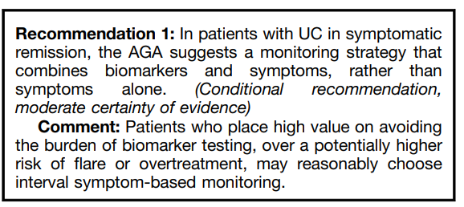
Patients With Ulcerative Colitis in Symptomatic Remission Question 1: In patients with UC in symptomatic remission, is interval biomarker-based monitoring superior to symptom-based monitoring to improve long-term outcomes?

Slide 37
Interval biomarker monitoring may be performed every 6–12 months.
Fecal biomarkers (fecal calprotectin or fecal lactoferrin) may be optimal for monitoring and may be particularly useful in patients where biomarkers have historically correlated with endoscopic disease activity.
A biomarker-based monitoring strategy, especially using stool-based tests, however, may be inconvenient and elevated biomarkers in otherwise asymptomatic individuals may lead to high patient anxiety. The diagnostic performance of these tests in a low pretest probability setting is suboptimal resulting in unacceptably high rates of false results
It is important to think about the downstream consequences of testing and associated costs. The optimal management strategy in cases of discrepancy between symptoms and biomarkers is unclear and would generally trigger additional endoscopic testing for confirmation or repeat biomarker testing.

Slide 38
Question 2: In patients with UC in symptomatic remission, at what (A) fecal calprotectin, (B) fecal lactoferrin, and (C) serum C-reactive protein cutoff can we accurately rule out active inflammation, obviating routine endoscopic assessment?

Slide 39
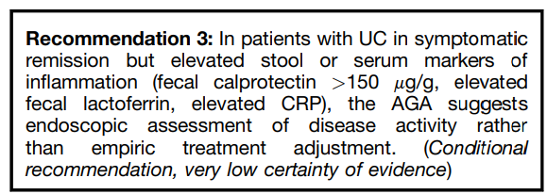

Slide 40
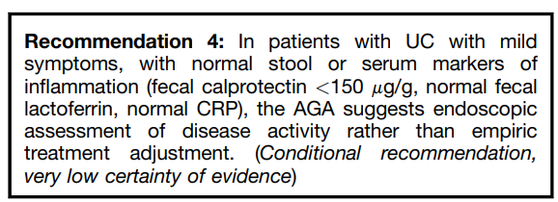

Slide 41
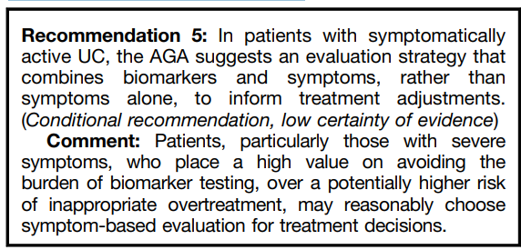
Question 3: In patients with symptomatically active UC, is an evaluation strategy that combines biomarkers and symptoms superior to symptom-based evaluation for making treatment adjustments?

Slide 42
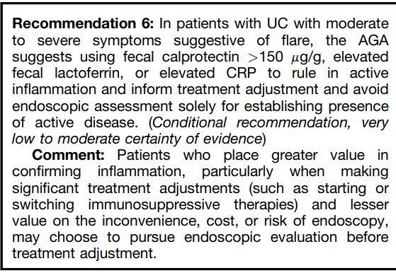
Question 4: In patients with symptomatically active UC, at what (A) fecal calprotectin, (B) fecal lactoferrin, and (C) serum C-reactive protein cutoff can we accurately diagnose active inflammation, obviating routine endoscopic assessment?

Slide 43
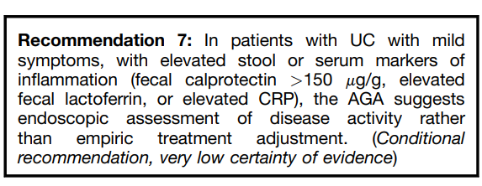

Slide 44
Question 5: In patients with established UC, is interval biomarker-based monitoring superior to endoscopybased monitoring to improve long-term outcomes?

Slide 45
Plans for Updating This Guideline
Guidelines are living products.
To remain useful, they need to be updated regularly as new information accumulates. This document will be updated when major new research is published. The need for update will be determined no later than 2026 and, if appropriate, we will provide rapid guidance updates to incorporate updated recommendations as new evidence, without duplicating or creating a new comprehensive guideline

